Slide 1
Expert System
An expert system is a computer program that is designed to solve complex problems and to provide decision-making ability like a human expert.
Characteristics of Expert Systems
High performance
Understandable
Reliable
Highly responsive

Slide 2
Capabilities of Expert System:
The expert systems are capable of −
Advising
Instructing and assisting human in decision making
Demonstrating
Deriving a solution
Diagnosing
Explaining
Interpreting input
Predicting results
Justifying the conclusion
Suggesting alternative options to a problem

Slide 3
Components of Expert Systems
The components of Expert System include :
User Interface
Inference Engine
Knowledge Base
The brief description of the components is as follow:
User Interface:- With the help of a user interface, the expert system interacts with the user, takes queries as an input in a readable format, and passes it to the inference engine. After getting the response from the inference engine, it displays the output to the user.

Slide 4
Components of Expert Systems
Inference Engine:- The inference engine is known as the brain of the expert system as it is the main processing unit of the system. It applies inference rules to the knowledge base to derive a conclusion or deduce new information. It helps in deriving an error-free solution of queries asked by the user.
With the help of an inference engine, the system extracts the knowledge from the knowledge base.
There are two types of inference engine:
Deterministic Inference engine: The conclusions drawn from this type of inference engine are assumed to be true. It is based on facts and rules.
Probabilistic Inference engine: This type of inference engine contains uncertainty in conclusions, and based on the probability.
Inference engine uses the below modes to derive the solutions:
Forward Chaining: It starts from the known facts and rules, and applies the inference rules to add their conclusion to the known facts.
Backward Chaining: It is a backward reasoning method that starts from the goal and works backward to prove the known facts.

Slide 5
Components of Expert Systems
Knowledge Base:- It contains domain-specific and high-quality knowledge. The success of any Expert System majorly depends upon the collection of highly accurate and precise knowledge.
Knowledge: Data, information, and past experience combined together are termed as knowledge.
Components of Knowledge Base
The knowledge base of an Expert System is a store of both, factual and heuristic knowledge.
Factual Knowledge − It is the information widely accepted by the Knowledge Engineers and scholars in the task domain.
Heuristic Knowledge − It is about practice, accurate judgement, one’s ability of evaluation, and guessing.
Knowledge representation
It is the method used to organize and formalize the knowledge in the knowledge base. It is in the form of IF-THEN-ELSE rules.
Knowledge Acquisition
The success of any expert system majorly depends on the quality, completeness, and accuracy of the information stored in the knowledge base.
Knowledge Engineer
The knowledge base is formed by readings from various experts, scholars, and the Knowledge Engineers. The knowledge engineer is a person with the qualities of empathy, quick learning, and case analyzing skills. He acquires information from subject expert by recording, interviewing, and observing him at work, etc. He then categorizes and organizes the information in a meaningful way, in the form of IF-THEN-ELSE rules, to be used by interference machine. The knowledge engineer also monitors the development of the Expert System.

Slide 6
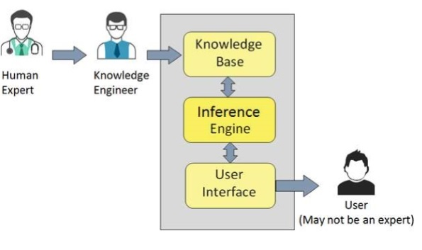
Expert System

Slide 7
MYCIN Case
MYCIN, an early expert system, or artificial intelligence (AI) program, for treating blood infections.
In 1972 work began on MYCIN at Stanford University in California.
MYCIN would attempt to diagnose patients based on reported symptoms and medical test results.
The program could request further information concerning the patient, as well as suggest additional laboratory tests, to arrive at a probable diagnosis, after which it would recommend a course of treatment.
If requested, MYCIN would explain the reasoning that led to its diagnosis and recommendation.
Using about 500 production rules, MYCIN operated at roughly the same level of competence as human specialists in blood infections and rather better than general practitioners.

Slide 8
Development Process
The working of an expert system by taking an example of MYCIN Expert System is as follow:
Firstly, Expert System should be fed with expert knowledge. In the case of MYCIN, human experts specialized in the medical field of bacterial infection, provide information about the causes, symptoms, and other knowledge in that domain.
The Knowledge Base of the MYCIN is updated successfully. In order to test it, the doctor provides a new problem to it. The problem is to identify the presence of the bacteria by inputting the details of a patient, including the symptoms, current condition, and medical history.
The Expert System will need a questionnaire to be filled by the patient to know the general information about the patient, such as gender, age, etc.
Now the system has collected all the information, so it will find the solution for the problem by applying if-then rules using the inference engine and using the facts stored within the Knowledge Base.
In the end, it will provide a response to the patient by using the user interface.

